Slide 1
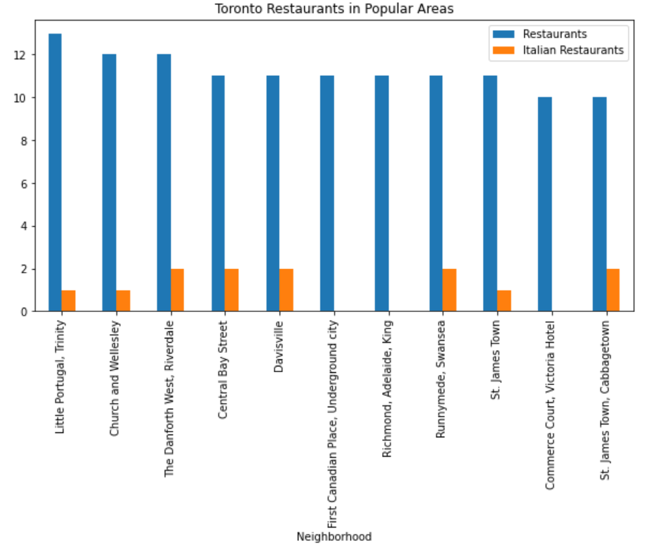
Where to Open an Italian Restaurant in Toronto?
There are 197 areas in Toronto.
The graph shows that in the busy areas in terms of high no of businesses and restaurants there are only 3 areas without an Italian Restaurant.
They are First Canadian Place, Richmond & Adelaide and Commerce Court.
Due to Richmond & Adelaide being close to a National Monument we have decided this is where we shall open our restaurant

